Slide 1

G2M Insight for Cab Investment Firm
Data Science Virtual Internship
Submitted by: Elissa Kuon
Date: January 14, 2023

Slide 2
Outline
INTRODUCTION
Data Information
Exploratory Data Analysis
MODEL BUILDING
FINAL STATEMENT

Slide 3
INTRODUCTION

Slide 4
Problem Statement
XYZ is a private equity firm in the US. Due to remarkable growth in the Cab Industry in the last few years and multiple key players in the market, it is planning for an investment in the Cab Industry.
Objective: Provide actionable insights to help XYZ firm in identifying the right company for making an investment
The analysis was divided into three parts:
Data Understanding
Visualization & Model Building
Recommendations for Investment

Slide 5
DATA INFORMATION

Slide 6
Data Background
Investigate and analyze four datasets to achieve insights within the cab industry:
Cab_Data.csv – includes details of transactions between the cab companies
Customer_ID.csv – a mapping table containing a unique identifier linking the customer’s demographic details
Transaction_ID.csv – a mapping table containing transaction to customer mapping and payment mode
City.csv – contains a list of US cities, along with their respective population, and the number of cab users
We proceed to combine all four datasets into one master data to work with

Slide 7
Data Background
The timeframe of our dataset is from January 1st, 2016, till December 31st, 2018
18 features with 359,392 observations
Assumptions:
Users are treated as the number of cab users in the city
Profit Margin is calculated by subtracting Cost_of_Trip from Price_Charged
Take into consideration the assumptions that are followed with model building and hypothesis testing
May affect the results we’ve obtained and may need further investigation, however, can be used as a baseline for understanding the Cab Industry

Slide 8
EXPLORATORY DATA ANALYSIS

Slide 9
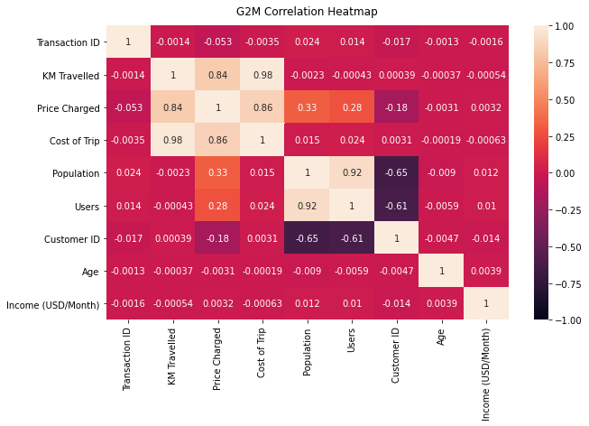
Correlation Between Variables
There is a strong correlation between the variables:
Population and Users
Price_Charged and KM Travelled
KM Travelled and Cost_of_Trip

Slide 10
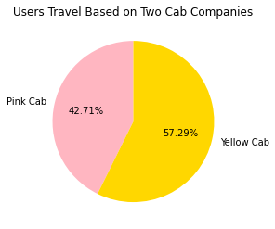
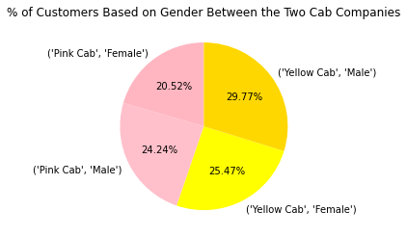
% of Cab Users and Gender Distribution
Users prefer to take Yellow Cab than Pink Cab, with a difference of 14.58%
Pretty even gender distribution overall, with slightly more male users by 0.29%

Slide 11
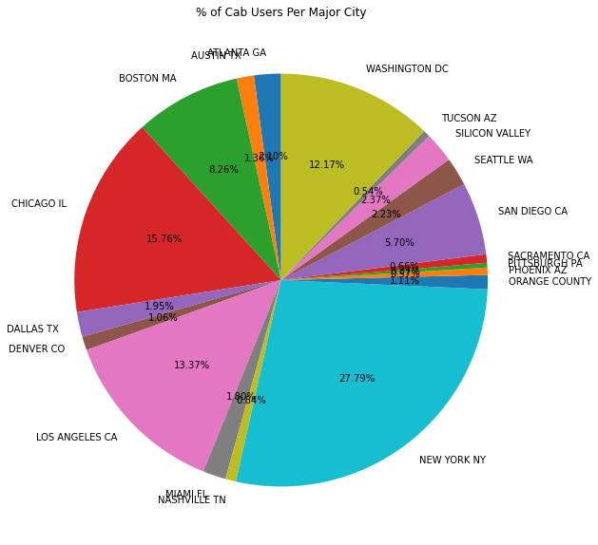
% of Cab Users Within US Major Cities
Most cab users reside in New York City with 27.79% of all cab users, followed by Chicago and Los Angeles

Slide 12
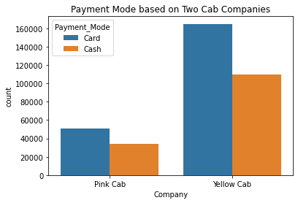
Payment Mode Distribution
Most cab users prefer to pay their rides through card payments than with cash for both companies

Slide 13
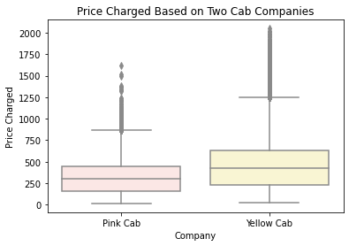
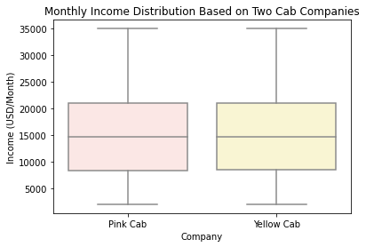
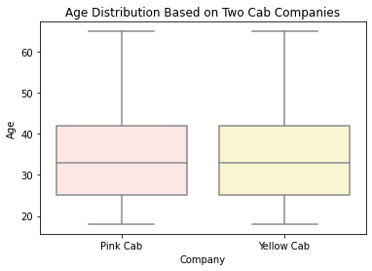
Price Charged, Income, and Age Distribution
Yellow Cab charged slightly higher for their cab services
For both companies, the average age of cab users is around 33 years old with an average monthly income of 15K USD

Slide 14
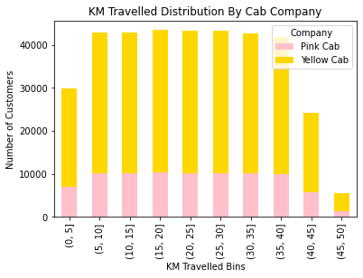
KM Travelled Distribution
Many cab users mostly travel between 5 – 40 km
Yellow Cab has a uniform shape in terms of distance traveled compared to Pink Cab
Note: A big difference between the two companies in short and long distances, where Yellow Cab has an overwhelmingly better coverage

Slide 15
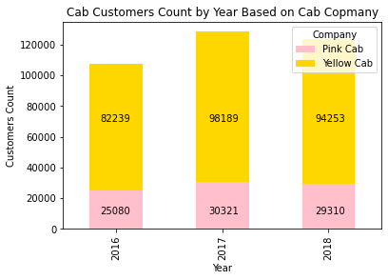
Users Count by Year
Yellow Cab has a higher customer count compared to Pink Cab
In the transition from 2017 to 2018, Yellow Cab suffered a 4.18% decrease in customers, while Pink Cab suffered a 3.45% decrease in customers

Slide 16
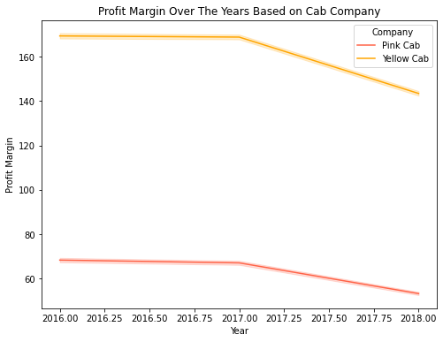
Profit Margin
Yellow Cab has a much higher profit margin in comparison to Pink Cab
Profit Margin for both cab companies decrease over the span of 2 years and may continue to decrease looking at the trend of the graph

Slide 17
MODEL BUILDING

Slide 18
Model Building Objective
Profit Margin will be treated as our targeted feature
Not interested in wanting to predict profit margin due to the complexity of the formulas of the models
More interested in the relationship between profit margin and the other features

Slide 19
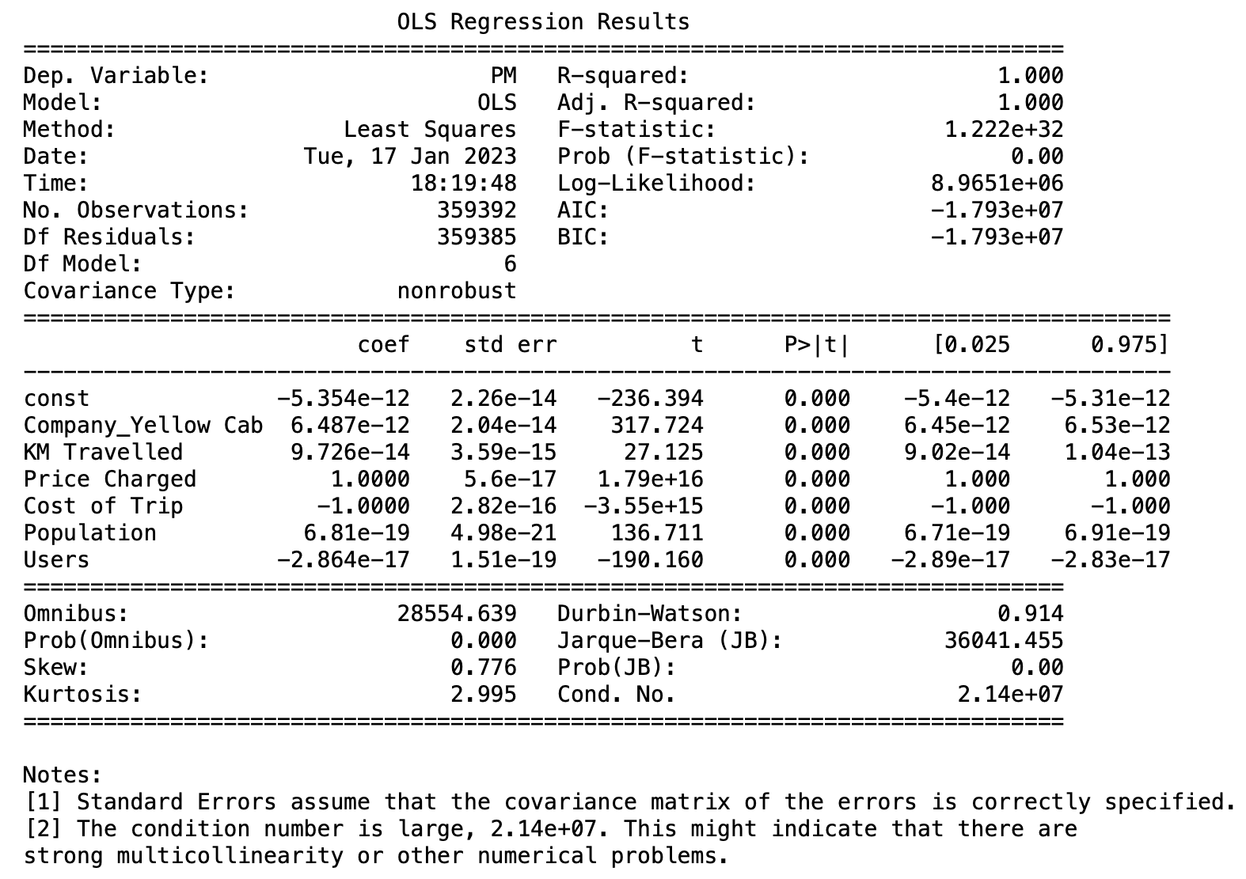
Linear Regression
Important features in inferencing Profit Margin is Company, KM Travelled, Price Charged, Cost of Trip, Population, and Users
Dropped Gender, Payment Mode, Age, and Income as they were deemed to not have any influence on Profit Margin

Slide 20
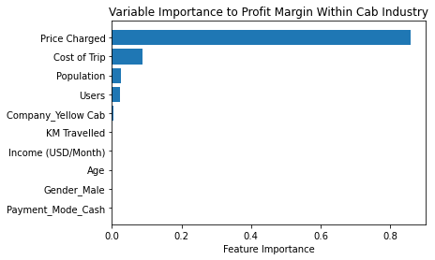
Random Forest
Price Charged is the most important feature in influencing Profit Margin
Cost of Trip, Users, Population, and Company have also some or little importance
Age, Gender, Income, and Payment Mode have no importance to Profit Margin
NOTE: This is in line with the variable importance of the linear regression model and hypothesis testing

Slide 21
FINAL STATEMENT

Slide 22
Recommendations
We have evaluated both cab companies and conclude Yellow Cab is better than Pink Cab:
Customer Reachability: Users mostly travel between 5 to 40 km. Overall, Yellow Cab has much better coverage covering short and long distances compared to Pink Cab. Yellow Cab customers consist of about three times more customers than Pink Cab customers
Expected Profit Margin and Users Count: Through statistical testing, there is strong evidence that the expected profit margin of Pink Cab is different than the expected profit margin of Yellow Cab. From the visualization, Yellow Cab has a much higher profit margin in comparison to Pink Cab. Based on the trend of the graphs between the user counts and profit margins within the span of 2 years, we are expected to see a steady decline.
Income-Wise: Through statistical testing, most users of Pink Cab and Yellow Cab are of the mid-income class with the low-income class being the least amount of cab users. Most of the users utilize Yellow Cab by a great amount in the low and high-income classes. Yellow Cab company has the highest number of users from the mid-income class compared to Pink Cab, covering all three income classes, greatly.
Based on the above points, we recommend Yellow Cab for investment. However, we must consider the assumptions we have made initially and may need to do further analysis for a more accurate insight.

Slide 23
THANK YOU

